Slide 1
Compilation Techniques (8)
Types Analysis
Recursive type definitions
Implicit and explicit casts
Left values (lval) and right values (rval)
Overloading
Templates (Generics)
TA algorithm
Type inference
© Codruta-Mihaela ISTIN 2015

Slide 2
Types Analysis (TA)
Checks if the components of an expression or statement are correctly used according with their types
Static Typed Languages (STL) generally fully define the types of the expressions components. In these languages the TA rules are stricter
Dynamic Typed Languages (DTL) generally do not define or define only partially the types of the expressions components. For example in JavaScript a variable can be an array (var v=[];) but the type of the array elements is not defined so it can contain any type of elements.
© Codruta-Mihaela ISTIN 2015

Slide 3
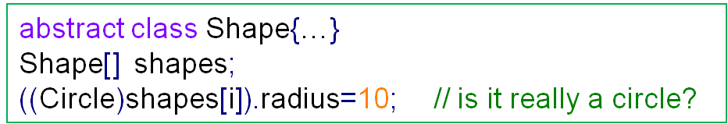
Full compile time TA
It is done in STL. All expression types are known at compile time.
It allows strict type checking which can highlight many errors and warnings:
  void functions which return a value or non-void functions which do not return a value
  possible loss of precision on different casts (ex: int -> char)
  non-integral values used for array indexes or array definitions
It enforces a better programming discipline at the expense of more written code (definitions, explicit casts)
The programs are faster, because at runtime TA is already done
Sometimes STL cannot guarantee full compile time TA. In this case runtime checks must be provided:
© Codruta-Mihaela ISTIN 2015

Slide 4
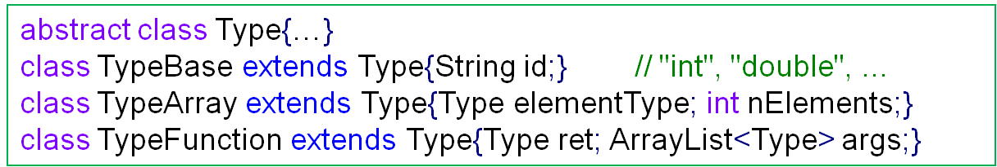
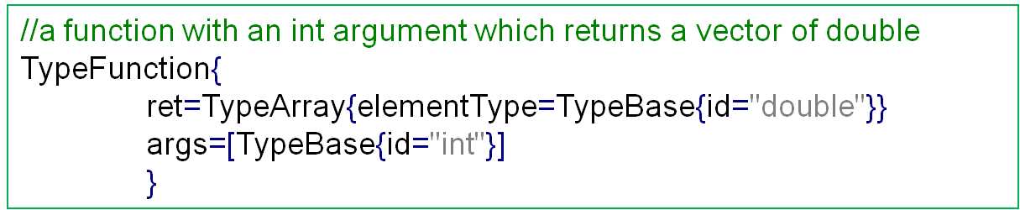
Recursive type definitions
Sometimes a type definition can be quite complex and it can be formed using an arbitrary large number of components:
const char **names(const char *prefix);
names is function with a “const char *” argument which returns a pointer to “const char *” (ex: all the names starting with the given prefix)
In these cases a recursive type definition can be given:
The end of the recursion is TypeBase. The validity of a type is enforced by the class hierarchy structure
© Codruta-Mihaela ISTIN 2015

Slide 5
Implicit and explicit casts
When a cast is made “a=(int)b”, three situations are possible:
  no action is taken but the original data is interpreted differently: (char*)malloc(…)
  the original data is converted to a type which can hold any value of the original type (widening casts): int i=(int)ch
  the original data is converted to a type which cannot hold some values of the original type (narrowing casts): char ch=(char)i
The widening casts do not pose any dangers so the programming languages allow them implicitly
The narrowing casts can sometimes loose precision so in some cases the programmer must provide them explicitly
Ex: if an “int” has 31 bits without sign and a “float” has a precision of 24 bits (the significand), it results that not any “int” can be fully stored into a “float”
© Codruta-Mihaela ISTIN 2015

Slide 6
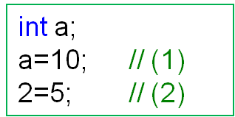
Left values and right values
In the examples (1) and (2) all types are “int” so why (1) is valid and (2) not?
Answer: besides a valid type, some operations (like the assignment) require not only a value but an address where a value can be stored
If an expression provides an address capable to store a value, we say that this member is a “lval” (left value). Examples: “a”, “v[5]”, “*p”.
If an expression provides only a value but not an address, we say that this member is a “rval” (right value). Examples: “5”, “a+3”, “!f”.
These names come from the possibility for an expression to be in the left part or in the right part of an assignment
© Codruta-Mihaela ISTIN 2015

Slide 7
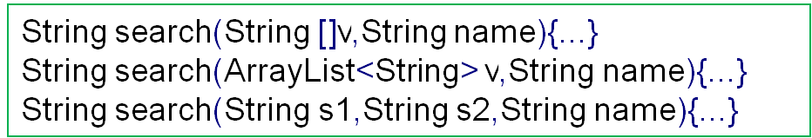
Overloading
The ability to create multiple methods with the same name but with different signatures
The signatures may differ by arity (number of arguments) or by the arguments types
Overloading was present from a long time in the case of operators (ex: “+” can add ints, floats, …) but in the case of methods it gained popularity mostly after the apparition of the OOP languages
Overloading poses special problems to domain and types analysis:
  the symbol table can have multiple symbols with the same name in the same context – when a symbol is redefined?
  for multiple methods with the same name and the same arity, how to decide which one to select, especially when implicit casts are allowed? (ex: search(null,”John”) will select for null “String[]” or “ArrayList<String>”? – an explicit cast for “null” must be given)
© Codruta-Mihaela ISTIN 2015

Slide 8
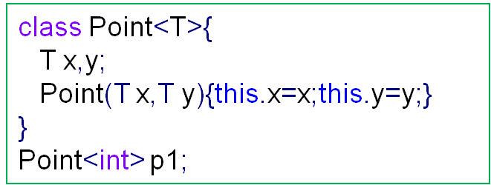
Templates (Generics)
The ability to create different types by giving different values to generic arguments (the template arguments)
The generic arguments can be types and in some languages they can also be compile time constants
Templates are very useful to provide compile time safety, especially for collections which differ only by their elements type and not by the associated operations
From a compiler point of view, a template instantiation (ex: Point<int>) is equivalent with defining a new type with the given generic arguments)
© Codruta-Mihaela ISTIN 2015

Slide 9
TA algorithm for STL
This algorithm works on an explicit or implicit Abstract Syntax Tree (as the one implicitly created on a recursive descent parsing)
All the symbols must be available in the symbols table (ST)
All constants must have predefined types (ex: integer values such as “21” can be of type “int” and float values such as “3.14” can be of type “double”). Some languages allow changing the default constants type using suffixes or other means (ex: “0.5f”, “1lli”)
In AST each expression node will return a synthesized attribute with all the required type information: type, if it is constant, if it is a lval. In the case of constants, the constant value itself is also returned.
The identifiers types are taken directly from ST
At each inner AST node all the type information coming from its children is combined and the resulted type and information is propagated further
© Codruta-Mihaela ISTIN 2015

Slide 10
Combining rules for TA algorithm
Some implicit conversion rules: a numeric type (integral or floating point) can be implicitly converted to a wider numeric type; a “void*” or “null” can be implicitly converted to any pointer type or reference; some languages also allow implicit conversion from integral to floating point types
For the arithmetic operators (+, -, *, /, …), if both operands have the same type, this will also be the resulted type, else the new type will result by applying the implicit conversion rules
The resulted type for a function call is its return type
The resulted type for an array indexing is the type of its elements
The resulted type of an explicit cast is the cast type
The resulted type of a member selector “a.b” is the member type
The resulted type for comparisons or logic operations can be “boolean” or “int”
If all operands are constants and the operation can be executed at compile time, the result can be computed and propagated further
© Codruta-Mihaela ISTIN 2015

Slide 11
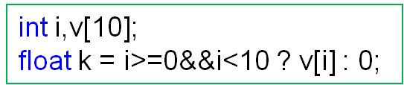
TA example
int -> float implicit cast inserted
int
nonct
rval
=
k
?:
int
ct=0
rval
int
nonct
rval
float
nonct
lval
int
nonct
lval
&&
[]
0
int
nonct
rval
>=
int
nonct
rval
<
v
i
int[]
nonct
lval
int
nonct
lval
int
nonct
lval
i
int
ct=0
rval
0
int
nonct
lval
i
int
ct=10
rval
10
© Codruta-Mihaela ISTIN 2015

Slide 12
Type Inference (1)
The ability to deduce a type from the surrounding context
In C# “()=>expression” is a lambda (anonymous) function. In the above function the lambda used is nowhere defined (what are its arguments and its return type?) and also “p” has no explicit type (what is its type?)
The compiler is capable to infer the type for lambda and for “p” from the surrounding context:
  “points” is of type “List<T>” with the generic argument “T” = “Point”
  the “ForEach” method of class “List<T>” has one parameter with the type “Action<T>”
  “Action<T>” is a delegate (a reference to a function) with one argument of type “T” which returns “void”, so the lambda type must be “void f(T)”
  Because “T” = “Point”, the lambda type is “void f(Point)” and the type of “p” is “Point”
© Codruta-Mihaela ISTIN 2015

Slide 13
Type Inference (2)
Type inference can reduce the code size by writing less declarations. It also ensures the correct type for a declaration. The code is also generic (ex: “let max a b=if a>b then a else b” works for every type which defines “>“). The code looks like a DTL but in fact it is a STL
Because of these aspects some languages try to rely solely on type inference (OCaml, Haskell) – they are STL but without explicit type declarations, all types being inferred
As disadvantages, a code without any type declarations can be harder to maintain, especially by other programmers than the author. These programmers must infer themselves the types of different variables in the same way the compiler does, which is not always easy.
Type inference can be implemented by creating a set of rules (constrains) with all the known elements and relations. This set of rules acts much like a system of equations in which the unknowns are the inferred types
Erroneous conditions can appear, for example if it is no type which can simultaneously satisfy some conditions or more than one type can satisfy the given conditions. In these cases type errors are reported.
© Codruta-Mihaela ISTIN 2015

Slide 14
Bibliography reading
Compilers. Principles, Techniques and Tools
6.3, 6.5
© Codruta-Mihaela ISTIN 2015

